Slide 1
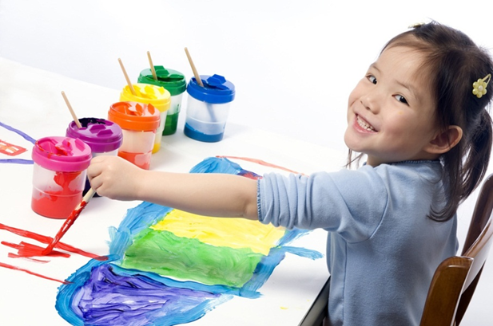
Play Therapy and Bereavement

Slide 2
Play
All children play naturally as their language. Play is their work.
The objective or goal of play therapy is to get the child to reveal, express, and/or deal with the internal pain they are feeling but are not articulating appropriately. As a counselor, you play along side the child and let child lead the play, even if it does not seem to make sense to you, it does to the child!!

Slide 3
Play Therapy
Definition--a form of counseling where a properly trained counselor plays therapeutically with children.
Used mostly with children 2-11 years old, but can be used appropriately for any age.
Music and art therapy is the most common of play therapy done with adults.

Slide 4
Directive VS. Non-Directive
Play therapy is split into 2 main areas.
Directive is when the counselor guides the counseling session by choosing the activities for the child(ren).
Non-directive (best to use)-child directed. Child chooses any activity to play in the playroom. This may not be possible if no playroom available. Offer all toys to child and let them chose-pencils/paper, music, books, etc.

Slide 5
Toys
Play therapy includes but is not limited to stuffed animals, art supplies, figurines, music/movement, emergency vehicles, dolls, doll house, sand/water table, children’s first aid kit, puzzles, puppets, board games, trucks/cars, stuffed animals, music, books, kitchen with play food and dishes, pirate ship, castle with knights, princess, dragons.

Slide 6
Play
Counselors should use the Carkuff model during play therapy. (match your client)
Use reflections, paraphrase, summarize, etc.
Only when child is ready should you try to play out a ‘new’ outcome for the child.
As the counseling sessions progress, counselors will see children expressing themselves better in and outside of the play room.

Slide 7
Grieving
There are grieving children every where.
In any school, community agency, clinical offices, you might find a child that misses a deceased loved one.
Children will react like the adults in their world—if mom, dad, grandma are crying and out of control, the child will be reacting the same way typically. If adults are isolating child, then child will be withdrawn from and with their feelings.

Slide 8
Play Therapy with Grieving Children
Benefits
In play, children will talk easier to you and invite you into their world.
Children will play out their concerns, fears, anxieties, etc.
Children will listen to you as you play along side them, even if they do not appear to be listening—Say something in reflection they did NOT say and they will correct you!
As you let the child lead the play they will show you what they need help with and eventually let you help them through the characters you are playing.
Challenges
They may appear as a behavioral issue instead of a grieving child.
Children are individuals just like adults, but not smaller adults.
Must take in developmentally and culturally competent issues.

Slide 9
“Helping children process death, particularly a traumatic death, is a challenge that requires knowledge of developmentally appropriate interventions and an understanding concerning the cultural and religious beliefs” (Baggerly, 2010).

Slide 10
Multiculturalism
Muslim
Approximately 6 million Muslims living in the United States (adults and children)
“33% are South Asian
30% are African American
25% are Arabic
and 12% are categorized as “other”
in the United States that are Muslim.
One of the fastest growing religions/culture and the most misunderstood!
As a counselor you will need to not only educate yourself on this population but also challenge your own beliefs about the culture and the negative stigma from 9/11.

Slide 11
Muslim
There are different branches of the Muslim religion
The one demonstrated in this presentation is Sunni Muslims' views
Approximately 85% to 90% of Muslims adhere to the Sunni tradition
The formal mourning period is 3 days
Following a death, neighbors may prepare food for the family or read them verses from the Quran
Some Muslims were surveyed 90% used prayer, 95% used confessions to God of one's wrong deeds, and 61% read the Quran.
Seeking counseling, for adults or children, is not typical

Slide 12
Muslim Beliefs and Traditions
Good deeds in life are rewarded with ‘jannah’ – eternal life in paradise
Children automatically receive ‘jannah’ because they have not reached the age of accountability.
Some Muslims believe in crying and wailing but most discourage any emotional outbursts about death (Sunni Muslim)
Believe that death is an honor not something to grieve.

Slide 13
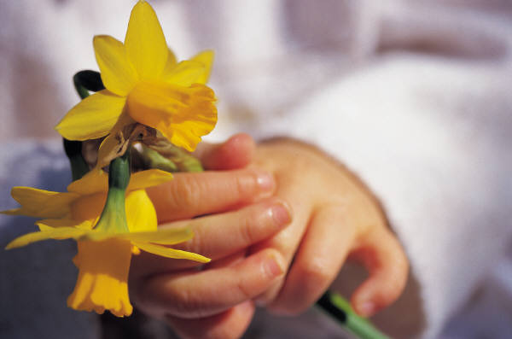
Grieving Muslim Children
Can promote art therapy, play therapy, or journaling in ways that are consistent with their faith.
Muslim children can do a good deed by making a sympathy card, use puppets to reenact the good deeds of the deceased.
Teach them coping skills by teaching them to stabilize themselves by taking deep breaths, excusing them to get a drink of water or visit the restroom, and providing them a quiet area to relax or pray at home and/or school.

